Slide 1
Robotic Systems for
Nursing Care
Leslie Janine González-Blancas
January 2025
Notes:
Technological advances in robotics
have made its use possible in new application fields like Nursing Care

Slide 2
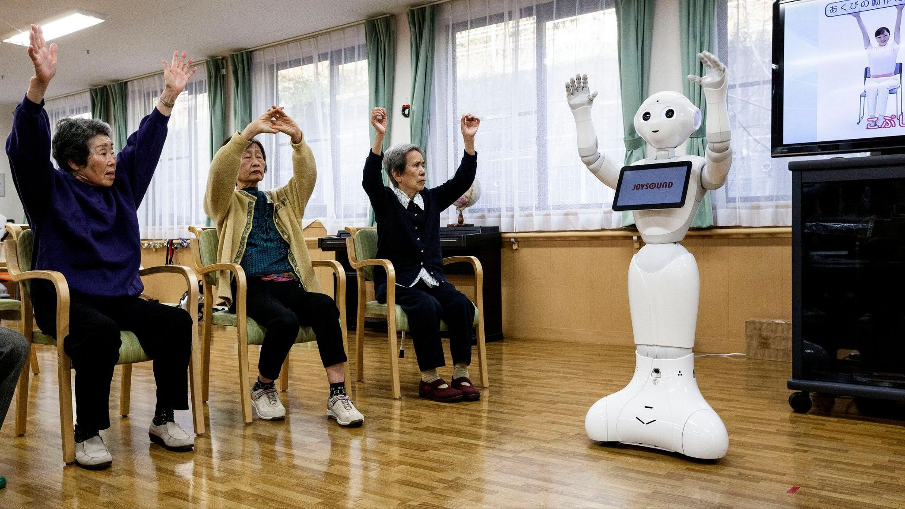
We refer to care robots as machines that operate partly or fully autonomously with the aim of supporting potential users, older adults and relatives, as well as professional caregivers, in providing physical, cognitive, or emotional support.
Notes:
Robotic nursing care is an emerging field, which enjoys global attention in various
research projects and some commercial systems.
In Johansson-Pajala et al. (2020), we found a definition of
care robots that matches our understanding, the authors say:
…
An important point we must keep in mind:
The introduction of robots in nursing care creates an active triangular collaboration between the
patient, nurse, and robot, which makes this area significantly different from
traditional human–robot interaction (HRI) settings

Slide 3
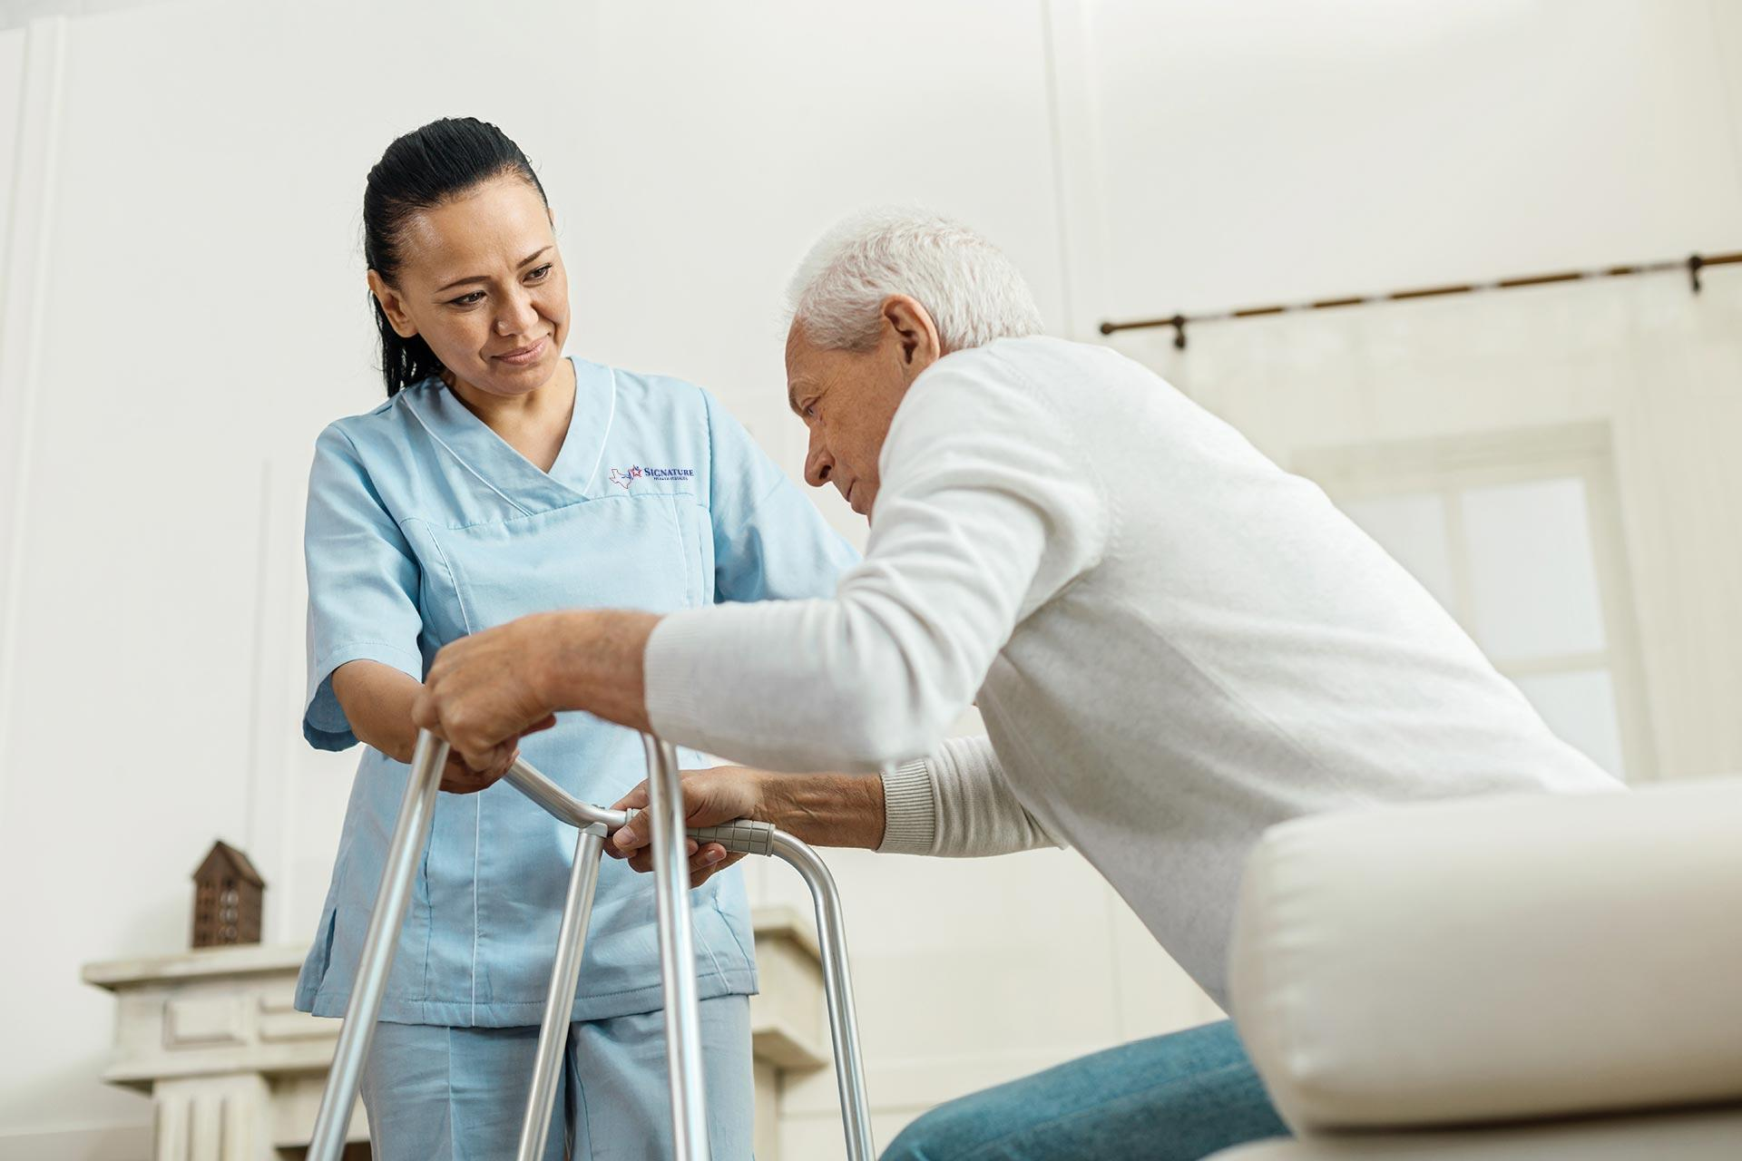
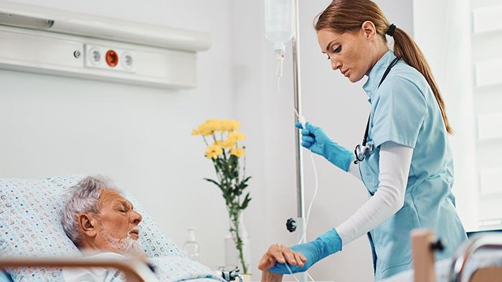
An increase in the aging population,
combined with the shortage of nursing staff,
makes the increasing need for care one of the main humanitarian challenges of the future.
Notes:
The challenging problem it tries to address is a combination of two factors…
According to the World Health Organization (2024), the global population is aging rapidly, and by 2050, the number of people aged 60 and older is expected to double to 2.1 billion, while the population aged 80 and older will triple.
By 2030,
1 in 6 people in the world will be aged 60 years or over.
At this time the share of the population aged 60 years and over
will increase from 1 billion in 2020 to 1.4 billion.
By 2050,
the world’s population of people aged 60 years and older will double (2.1 billion).
The number of persons aged 80 years or older is expected to triple between 2020 and 2050 to reach 426 million.

Slide 4
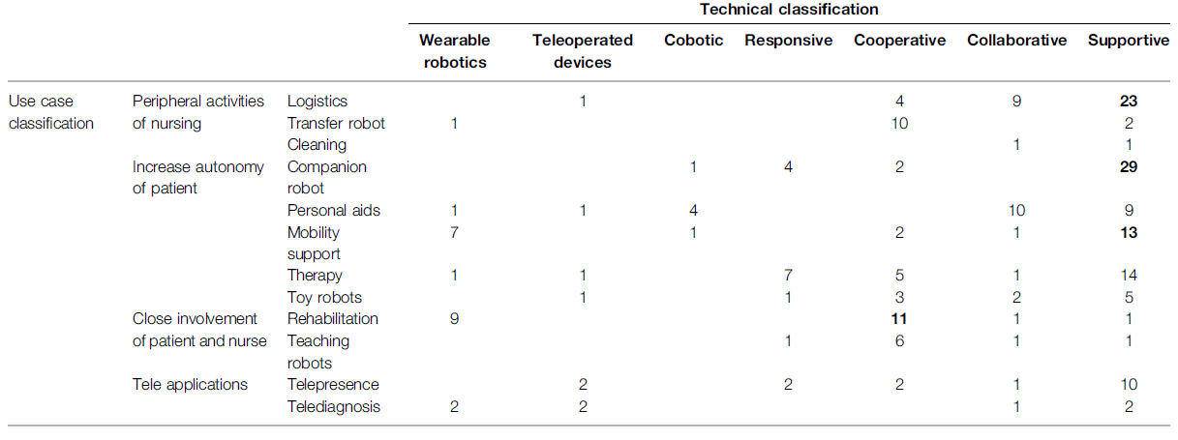
Classification
Notes:
to what extent it does…
technical classification that allows a structured view of what kind of robotic technologies are available on the market or in research.
parameters, proximity and autonomy, were assigned and used for classification.
For proximity, we considered how close the interaction with the patient or caregiver is as two different dimensions.
For autonomy, we considered to which degree the robot could act independently, or conversely, to which degree it was (remote) controlled.

Slide 5
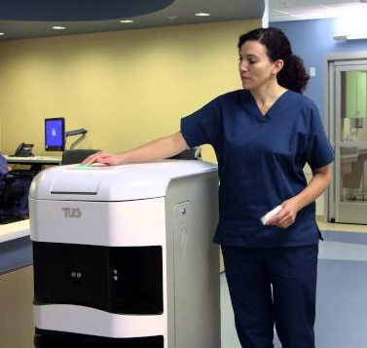
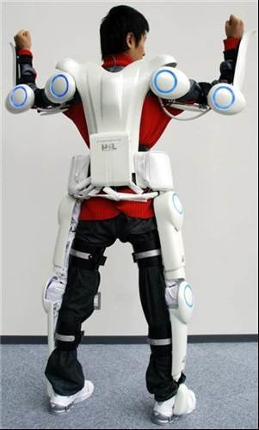
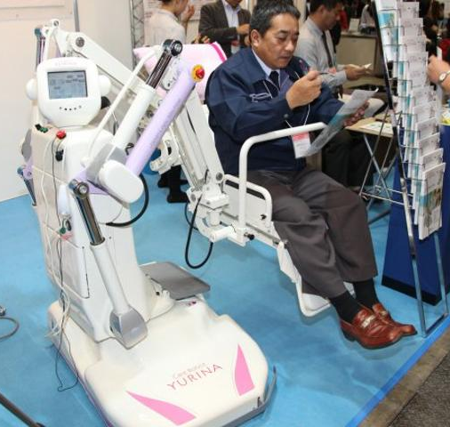
TUG
Robot Suit Hal
Care Robot Yurina
Supportive
Wearable Robotics
Cooperative
Notes:
Tug: product designed to help nurses, patients have no contact with it. Delivers food or medicine to the patients.
Supportive (where robots assist in the performance of the task, providing tools or information),
Care Robot Yurina: designed to help in the lifting and transportation of patients or to be used as an electric wheelchair;
Cooperative (where the human and robot share the control of the task in a continuous and cooperative way)
Robot Suit Hal and Rewalk: used for medical treatments of functional improvement of patients with cerebral, nervous, or muscle disorders, namely, spinal cord injury and cerebral embolism
from the patient’s point of view, it is “personal”, as it is attached to the patient’s body.

Slide 6
Advantages
Disadvantages
Improved Access to Healthcare.
Continuous Monitoring.
Infection Risk Reduction.
Cost-effectiveness.
Enhanced Resource Management
Privacy Concerns.
Security Issues.
Ethical and Emotional Limitations.
Accountability and Reliability.
Psychological and Social Impact.
Technical Failures.
Notes:
whether it unlocked other usages/problems.
the
robot performs a task for the user,

Slide 7
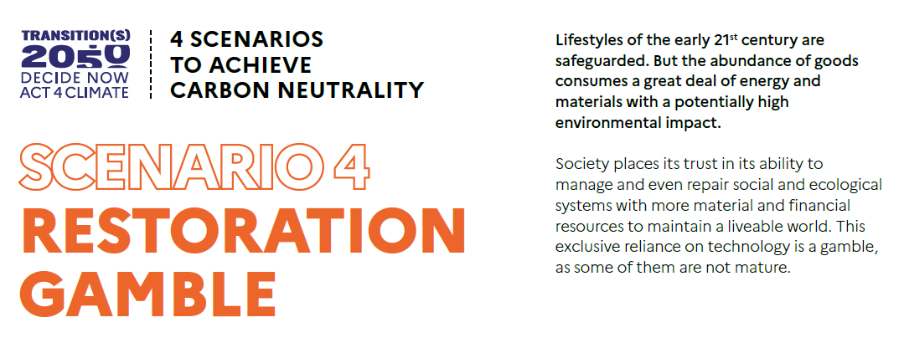

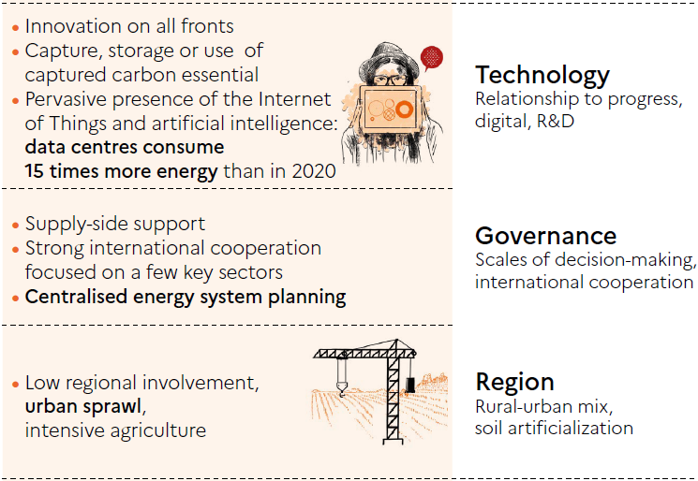
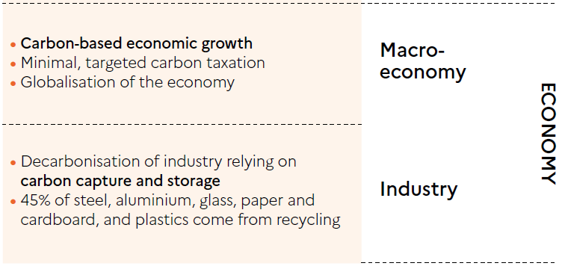
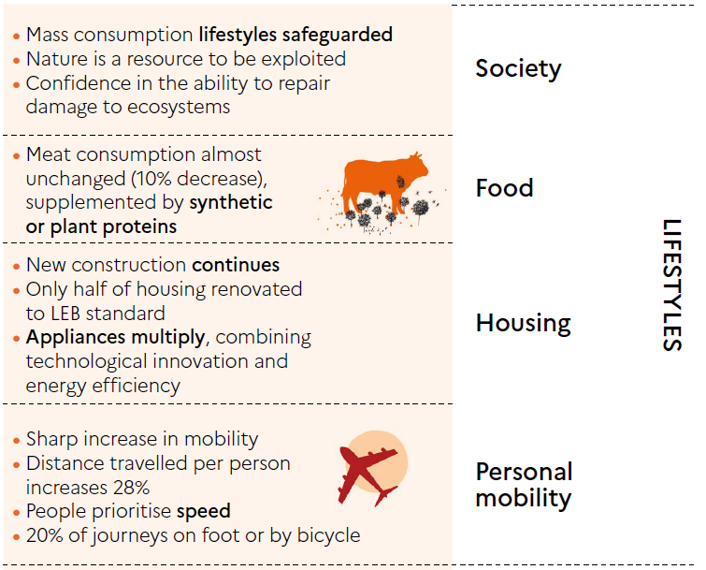
Notes:
Indicate in which of the 4th scenarios of the ADEME (https://transitions2050.ademe.fr/en) this technology is rooted.
In the four scenarios, industry is transformed not only to adapt to radically changing demand but also to decarbonise its production
with a very high consumption of resources.
In S3 and S4, the level of emissions to be offset increases and the greater use of natural environments reduces the potential of sinks: technological sinks therefore become necessary

Slide 8
References
Nieto Agraz C, Pfingsthorn M, Gliesche P, Eichelberg M and Hein A (2022) A Survey of Robotic Systems for Nursing Care. Front. Robot. AI 9:832248. doi:10.3389/frobt.2022.832248

Slide 9
The End
Thank you!
Janine 💖

Slide 10


The global population is aging rapidly, and by 2050, the number of people aged 60 and older is expected to double to 2.1 billion, while the population aged 80 and older will triple.
World Health Organization. (2024, October). Ageing and health. Retrieved from https://www.who.int/news-room/fact-sheets/detail/ageing-and-health
Notes:
The challenging problem it tries to address is a combination of two factors…
According to the World Health Organization (2024), the global population is aging rapidly, and by 2050, the number of people aged 60 and older is expected to double to 2.1 billion, while the population aged 80 and older will triple.
By 2030,
1 in 6 people in the world will be aged 60 years or over.
At this time the share of the population aged 60 years and over
will increase from 1 billion in 2020 to 1.4 billion.
By 2050,
the world’s population of people aged 60 years and older will double (2.1 billion).
The number of persons aged 80 years or older is expected to triple between 2020 and 2050 to reach 426 million.

Slide 11

An increase in the aging population,
combined with the shortage of nursing staff,
makes the increasing need for care one of the main humanitarian challenges of the future.
Nieto Agraz C, Pfingsthorn M, Gliesche P, Eichelberg M and Hein A (2022) A Survey of Robotic Systems for Nursing Care. Front. Robot. AI 9:832248. doi:10.3389/frobt.2022.832248
Notes:
The challenging problem it tries to address is a combination of two factors…
According to the World Health Organization (2024), the global population is aging rapidly, and by 2050, the number of people aged 60 and older is expected to double to 2.1 billion, while the population aged 80 and older will triple.
By 2030,
1 in 6 people in the world will be aged 60 years or over.
At this time the share of the population aged 60 years and over
will increase from 1 billion in 2020 to 1.4 billion.
By 2050,
the world’s population of people aged 60 years and older will double (2.1 billion).
The number of persons aged 80 years or older is expected to triple between 2020 and 2050 to reach 426 million.

Slide 12
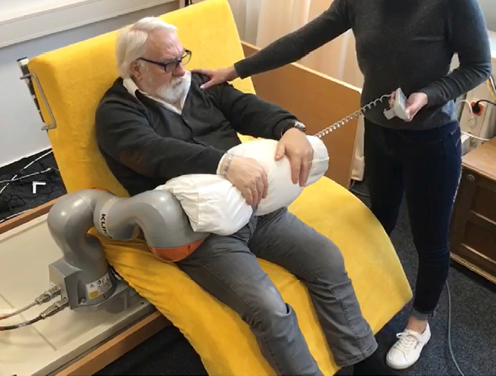
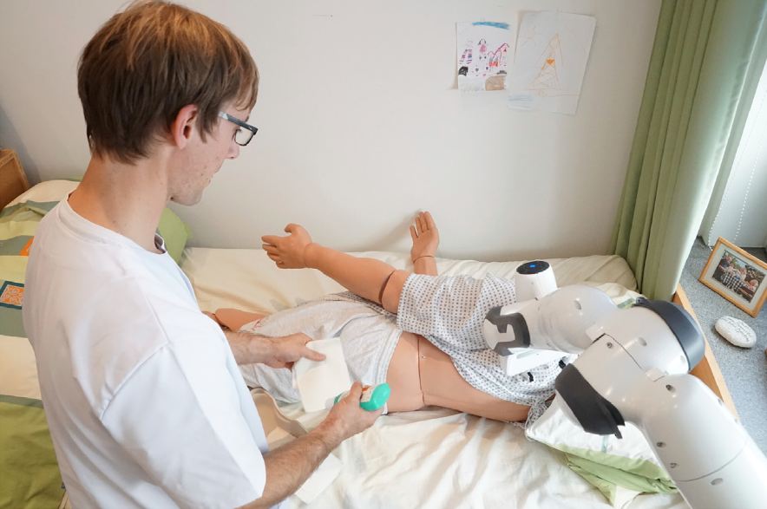
“we refer to care robots as machines that operate partly or fully autonomously with the aim of supporting potential users, older adults and relatives, as well as professional caregivers, in providing physical, cognitive, or emotional support.”
Notes:
To what extent it does
Robotic nursing care is an emerging field, which enjoys global attention in various
research projects and some commercial systems.
In Johansson-Pajala et al. (2020), we found a definition of
care robots that matches our understanding, the authors say:

Slide 13
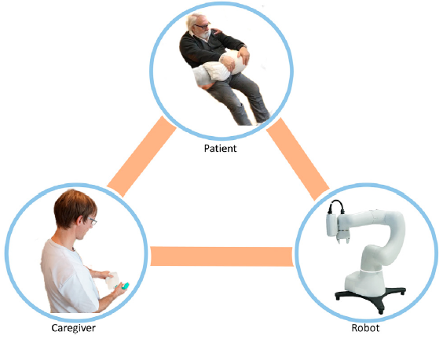
Triangular collaboration
Notes:
An important point we must keep in mind:
The introduction of robots in nursing care creates an active triangular collaboration between the
patient, nurse, and robot, which makes this area significantly different from traditional human–robot interaction (HRI) settings

Slide 14
Bringing objects from another place.
Reducing the feeling of loneliness.
Set reminders.
Keep in touch with relatives.
Help user perform an activity of daily life.
Improve the rehabilitation effectiveness.
Perform actions reducing the risk of infection.
Work together to fulfill a task.
Provide information to the user.
Reduce the isolation of the patient.
Notes:
whether it unlocked other usages/problems.
the
robot performs a task for the user,

